Slide 1
Community ecology
Community: A group of several species (plants and/or animals) living together with mutual tolerance (adjustment) and beneficial interactions in a natural area is known as a community. Or
All the organisms that inhabit a particular area; an assemblage of populations of different species living close enough together for potential interaction
Characteristic of a community
(1) Species diversity: Each community is made up of much different organisms- plants, microbes, animals, which differ taxonomically from each other. The number of species and population abundance in community also vary greatly.
There are two levels of species diversity:
Regional diversity of whole nations or parts of continents within which many different communities exists.
Local diversity in a given nation where different communities exist at different latitudes.
(2) Growth form and structure: community is described in terms of major growth forms as trees, shrubs, herbs, mosses etc. In each growth form as in trees, there may be different kind of plants as broad leaved trees, evergreen trees etc. These different growth forms determines the structural pattern of community.
According to the mode of arrangement of the various growth forms, the communities exhibit:
Zonation-horizontal layering
Stratification- vertical layering.

Slide 2
(3) Dominance: In each community, all the species are not equally important. There are relatively only a few of these, which determine the nature of the community. These few species exert a major controlling influence on the community. Such species are known as dominants.
(4) Succession: Each community has its own development history. It develops as a result of a directional change in it with time.
(5) Trophic structure (self-sufficiency) : Nutritionally, each community, a group of autotrophic plants as well as heterotrophic animals, exists as a self-sufficient, perfectly balanced assemblage of organisms.

Slide 3
Composition, Structure, Origin and Development of a Community
Composition:
Communities may be large or small. Larger one extends over areas of several thousands of square kilometers, as forest. Others such as deserts, etc., are comparatively smaller, and still others such as meadows, ponds, rivers, etc, covering a very restricted area. Very small-sized communities are the groups of microorganisms in such microhabitats as leaf surface, fallen log, litter, soil, etc. The number of species and population abundance in communities vary greatly.
Among several species present in a community a few exert a major controlling influence on the growth of other species of the community. These are called as ecological dominants or dominant species.
Structure:
The communities exhibit a structure of recognizable pattern in the spatial arrangement of members of the communities. Thus, structurally, a community may be divided horizontally into subcommunities’, which are units of homogenous life forms and ecological relation. This horizontal division constitutes the zonation in the community. For example in deep ponds and lakes, there may be recognised three zones, viz, littoral zone, limnetic zone and profoundal zone. In each zone, organisms differ from each other.
Another aspect of structure that is more common is stratification which involves vertical rather than horizontal changes within the community. Vertical gradients in environmental factors such as the availability of sunlight, the temperature and so on bring about a recognizable stratification in water bodies, particularly in marine community.

Slide 4
Origin and development:
A community with its particular environment constitutes an entity which has its origin and development. Communities are never stable, but dynamic, changing more or less regularly over time and space. The occurrence of relatively definite sequence of communities over a period of time in the same area is known as ecological succession.
In a barren area there reach the seeds and propagules of the species which is known as migration.
These seeds or propagules after germination develop into the seedlings which then develop into adults. But only a few of these survive and are capable of successful growth, and this process of seedling establishment and successful growth is called ecesis.
As a result of migration and subsequent ecesis, species colonise the new areas—colonization. By this time with the changing environment due to plants growth several other species of both plants and animals start colonising the area and sooner or later the area is colonised by a definite community.

Slide 5
Characters used in community structure
Generally, analysis of community characters is being done for two specific purposes:
(i) To record variation within and between communities and
(ii) For naming and classifying communities.
Analytical characteristics are those features of community which can be observed or measured directly in each aspect. It involves measurements of various characters in sample plots, commonly known as quadrats. Measurements made in sample plots (quadrats) are scientifically processed to reflect the characteristics of the entire community.
Two sets of characters, viz.:
(i) Analytical, and
(ii) Synthetic are studied in a community at the same time.
1. Analytic Characters:
They are directly observed or measured in sample plots. They include kinds and number of species, distribution of individuals, number of individuals, height of plants, etc.
2. Synthetic Characters:
They are derived from the measurements of analytic characters and utilise data obtained in the analysis of a number of stands.

Slide 6
Analytical characters are of two types:
(i) Qualitative:
They are based on non-quantitative observations, e.g., species composition and stratification of vegetation. They are expressed only in qualitative way.
(ii) Quantitative:
They are expressed in quantitative terms. They are measured. The major quantitative characters include frequency, diversity, cover, biomass, leaf size, abundance, dominance, etc.
They are as follows:
Frequency: This is based on percentage of sample plots in which a species is present, indicating its dispersion in space.
This frequency of each species is calculated as follows:
Frequency percentage = number of sampling units in which that species occurred / number of sampling units studied Χ 100
Density: Density represents the numerical strength of a species in the community. The number of individuals of that species in any unit area is its density. This gives an idea of degree of competition.
It is calculated as follows:
Density = Number of individuals of the species in all the sampling unit/Total number of sampling units studied
The value thus obtained is then expressed as number of individuals per unit area.
Abundance: This is the number of individuals of any species per sampling unit of occurrence.
It is calculated as follows:
Abundance =Total number of individuals of the species in all the sampling units/Number of sampling units studied

Slide 7
Cover and Basal Area:
This is percentage land area occupied by a species, indicating the influence zone of a species. Although sometimes used in general sense for the area occupied by a plant, (which may be the herbage cover or the cover of basal area), it is generally used for above ground parts.
Thus, cover or herbage cover signifies primarily the area of the ground occupied by the above ground parts of plants, such as leaves, stems and inflorescences as viewed from above.
However, basal area refers to the ground actually penetrated by the stems and is readily seen when the leaves and stems are clipped at the ground surface. It is one of the chief characteristics to determine dominance. It is measured either at 2.5 cm above ground or actually on the ground level.
Biomass:
This expresses quantity of living materials per unit area, indicating the growth of a species. Thus, biomass is the standing crop expressed in terms of weight (i.e., organism mass) of the living matter present. The amount of living material, present in a component population at any time, is known as the standing crop, which may be expressed in terms of weight per unit area.
Leaf Area:
The percentages of species having different leaf sizes, indicating the adaptation of the vegetation to the prevailing environment. As the leaves are essential part and are very much affected by climate condition, their shapes and sizes have been taken as important criteria in determination of quantitative characters.

Slide 8
Qualitative characters
These include physiognomy, phenology, stratification, abundance, sociability, vitality and vigour, life form (growth form), etc.
Physiognomy:
This is the general appearance of vegetation as determined by the growth form of dominant species. Such a characteristic appearance can be expressed by single term. For example, on the basis of appearance of a community having trees and some shrubs as the dominants, it can be concluded that it is a forest.
Phenology:
It is the scientific study of seasonal change i.e., the periodic phenomenon of organisms in relation to their climate. Different species have different periods of seed germi­nation, vegetative growth, flowering and fruiting, leaf fall, seed and fruit dispersal, etc.
Such data for individual species are recorded. A study of the date and time of these events is phenology. In other words phenology is the calender of events in the life history of the plant. Environmental factors tend to influence the phenological behaviour of a species population.

Slide 9
Stratification:
Stratification of communities is the way in which plants of different species are arranged in different vertical layers in order to make full use of the available physical and physiological requirements.
Abundance:
Plants are not found uniformly distributed in an area. They are found in smaller patches or groups, differing in number at each place. Abundance is divided in five arbitrary groups depending upon the number of plants. The groups are very rare, rare, common, frequent and very much frequent.
Sociability:
Sociability or gregariousness expresses the degree of association between species. It denotes the proximity of plants to one another. Braun-Blanquet (1932) classified plants into the following five sociability groups:
S₁ – Plants found quite separately from each other, growing singly
S₂ – Plants growing in small groups (4 to 6 plants)
S₃ – Plants growing in small scattered patches.
S₄ – Several bigger groups of many plants at one place
S₅ – A large group occupying larger area.

Slide 10
Vitality:
It is the capacity of normal growth and reproduction which are important for successful survival of species. In plants, stem height, root length, leaf area, leaf number, number and weight of flowers, fruits, seeds, etc., determine the vitality.
Life form (growth form):
Ecologists generally use Christen Raunkiaer’s classification (1934) of plant life forms. A life form is “the sum of the adaptation of the plant to climate”. On the basis of the position of perennating buds on plants and the degree of their protection during adverse conditions, Raunkiaer classified plants into five broad life-form categories which are as follows:
Phanerophytes: Their buds are naked or covered with scale, and are situated high upon the plant. These life forms include trees, shrubs and climbers generally common in tropical climates.
Chamaephytes: In these plants, the buds are situated close to the ground surface which gets protection from fallen leaves and snow cover. Chamaephytes commonly occur in high altitudes and latitudes, e.g., Trifolium repens.
Hemicryptophytes: These are mostly found in cold temperate zone. Their buds are hidden under soil surface protected by the soil itself. Their shoots generally die each year. Examples— most of the biennial and perennial herbs.
Cryptophytes or Geophytes: In these plants, the buds are completely hidden in the soil as bulbs and rhizomes. Cryptophytes include the hydrophytes (buds remaining under water), halophytes (marshy plants with rhizomes under the soil) and geophytes (terrestrial plants with underground rhizomes or tubers).
Therophytes: These are seasonal plants, completing their life cycle in a single favourable season, and remain dormant throughout the rest unfavourable period of year in the form of seeds. They are commonly found in dry, hot or cold environment (deserts).

Slide 11
Synthetic characters
These are determined after computing the data on the quantitative and qualitative characters of the community. For comparing the vegetation of different areas, community comparison needs the calculation of their synthetic characters. Synthetic characters are determined in terms of the following parameters:
Presence and Constance:
It expresses the extent of occurrence of the individuals of a particular species in the community, i.e., how uniformly a species occurs in a number of stands of the same type of community. The species on the basis of its percentage frequency may belong to any of following five presence classes that were first proposed by Braun-Blanquet.
(a) Rare—present in 1 to 20% of the sampling units.
(b) Seldom present—present in 21-40% of the sampling units.
(c) Often present—present in 41-60% of the sampling units.
(d) Mostly present—present in 61-80% of the sampling units.
(e) Constantly present—present in 81-100% of the sampling units.
Fidelity:
Fidelity or “Faithfulness” is the degree with which a species is restricted in distribution to one kind of community. Such species are sometimes known as indicators. The species have been grouped into five fidelity classes which were first formulated by Braun Blanquet:
(a) Fidelity 1:
Plants appearing accidentally (Strangers)
(b) Fidelity 2:
Indifferent plants may occur in any community (Indifferents).
(c) Fidelity 3:
Species which occur in several kinds of communities but are predominant in one (Preferentials).
(d) Fidelity 4:
Specially present in one community but may occasionally occur in other communities as well (Selectives).
(e) Fidelity 5:
Occur only in one particular community and not in others (Exclusives).

Slide 12
Dominance:
It is used as a synthetic as well as analytical characters (Daubenmire, 1959). The number of organisms sometimes may not give correct idea of the species. If one bases his conclusion on number, a single or few trees in a grassland, or few grasses in a forest should be of little value. But if he considers the species on the basis of area occupied or biomass, the situation may be different. Thus, cover is included as an important character in dominance. Relative dominance (cover; RDO) is calculated as follows:
Relative Dominance (lover) = Dominance (cover) of the species / Total dominance (cover) of all the species x 100
Importance Value Index (IVI):
This index is used to determine the overall importance of each species in the community structure. In calculating this index, the percentage values of the relative frequency, relative density and relative dominance are summed up together and this value is designated as IV or importance value index of the species. It provides the idea of the sociological structure of a species in its totality in the community, but does not indicate its position separately with regard to other aspects.
For IV, values of relative density, relative frequency and relative dominance are obtained as follows:
Relative Density = Density of the species / Total density of all the species x 100
Relative Frequency = Frequency of the species / Total Frequency of all the species x 100
Relative Dominance = Dominance (cover) of the species / Total dominance (cover) of all the species x 100
Other synthetic characters:
Besides the above mentioned ones, there have also been proposed some other characters which have been quite useful in comparative studies on communities. Such characters include, interspecific association and association index, index of similarity, dominance index, diversity index etc.

Slide 13
Methods of study of communities
Various methods of study of plant communities are broadly grouped into three major categories
Floristic method: These are rather obsolete methods. Here flora is studied by listing various genera and species present in the community. Thus, vegetation is described in terms of the flora. These are actually descriptive methods. Such methods, however , give little or no idea of the composition, structure, growth forms etc of the community.
Physiognomic methods : The various species of the of the community are studied chiefly in terms of their life forms (growth forms), general stature, spread etc. Out of various methods, Raunkiaer’s life form method became most popular
Raunkiaer’s life form method : This method has two parts
Record of different life forms: The various species of the community are recorded. These are then distributed among the different life forms i.e. phanerophytes, chamaephytes, hemicryptophytes, cryptophytes and therophytes, on the basis of the position of renewal bud or organs in the species.
Biological (phyto-climatic) spectrum represents the percentage distribution of species among the various life forms

Slide 14
Phytosociological methods
In phytosociological methods, there are three forms of sampling units : area, line, and point.
In area and line , there is a definite area for sampling but in forests with long grassy and shrubby belts, it is difficult to have a definite area. For such analysis, point is taken as a sampling unit.
On basis of sampling units, there are three popular methods of study of communities:
Quadrat method, where the sampling unit is definite area which is taken in the form of square, a rectangle, or a circle.
Transect method, where the sampling unit is line of suitable length. A segment of suitable length along the line may be considered as a quadrat.
Point method, where the sampling unit is a point.
(1) Quadrat method : The quadrat is a square sample plot or unit for a detailed analysis of vegetation. It may be a single sample plot or may be divided into several subplots. In vegetational analysis, quadrats of any size, shape, number and arrangement may be used.

Slide 15
Kinds of Quadrats:
Quadrats are named according to the use. These are of the following types:
List quadrats: When the organisms encountered in the sample plot are listed by their names, the quadrat is called list quadrat. It includes all the species botanically identified or otherwise. A series of list quadrats gives floristic analysis of the community. This is used for studying the frequency of different species.
Count quadrat or list-count quadrat: When the species name and the number of individuals of each species found in the sample area are recorded, the sample plot is called count or list-count quadrat. This type of plot is usually used in forest survey work.
Cover quadrat: When the actual or relative coverage is recorded usually as percentage of ground area covered or shaded by vegetation, the sample area is known as cover quadrat
Chart quadrat: Quadrats that are mapped to scales to show the location of individuals of species are called chart quadrats. Individuals plants are recorded on miniature quadrat on a graph paper often with the help of an instrument called pantograph. This is very tedious work but where long range studies of vegetational changes are being made, this method provides a big picture. So far as the distribution of quadrats in the study area is concerned, statistically reliable estimates are obtained by randomized plots.
Study of community by quadrat method involve three steps
To determine minimum size of quadrat by Species-Area curve method
To determine the minimum number of quadrats to be laid down and
Record of species- their listing, and counting of the individuals of each species.

Slide 16
(2) Transect Method:
A cross-section of an area used as a sample for recording, mapping or studying vegetation is called transect. It may be a strip, belt or a line across the area of study. The species occurring along these strips or lines are recorded. Because transect is continuous through the study area, it can be applied in studying the gradual and continuous changes in the vegetation along the line or strip with the change in environment. On the sloppy area, the transect is laid between two points at different altitudes.
The transects are of two types:
(i) Belt transect: is a belt of suitable breadth, used for forests.
(ii) Line transect: is a thin line, which is generally used for grasslands
(3) The Loop Method:
This is a simple, accurate and quick method for sampling of only grassland and low herbaceous communities. It is used for determining community composition, species frequency and range condition. In this method equally spaced 100 small circles or loops located along a stretched line are used as observation points
(4) Pointless or Point Method:
In this method of sampling observations are taken on the point in the study area where a nail or set of nails touch the ground on grid lines or at random places.
Two methods used are:
(i) Point frame method.
(ii) Point centre method.

Slide 17
Ecotone
An ecotone is a zone of junction or a transition area between two biomes [diverse ecosystems]. It is where two communities meet and integrate.
For e.g. the mangrove forests represent an ecotone between marine and terrestrial ecosystem. Other examples are grassland (between forest and desert), estuary (between fresh water and salt water) and river bank or marsh land (between dry and wet).
Characteristics of Ecotone
It may be narrow (between grassland and forest) or wide (between forest and desert).
As it is a zone of transition, it has conditions intermediate to the adjacent ecosystems. Hence it is a zone of tension.
Usually, the number and the population density of the species of an outgoing community decreases as we move away from community or ecosystem.
A well-developed ecotones contain some organisms which are entirely different from that of the adjoining communities.
Edge Effect – Edge Species
In ecology, edge effects refer to the changes in population or community structures that occur at the boundary of two habitats (ecotone).
Sometimes the number of species and the population density of some of the species in the ecotone is much greater than either community. This is called edge effect.
The organisms which occur primarily or most abundantly in this zone are known as edge species.
In the terrestrial ecosystems edge effect is especially applicable to birds. For example the density of birds is greater in the mixed habitat of the ecotone between the forest and the desert

Slide 18
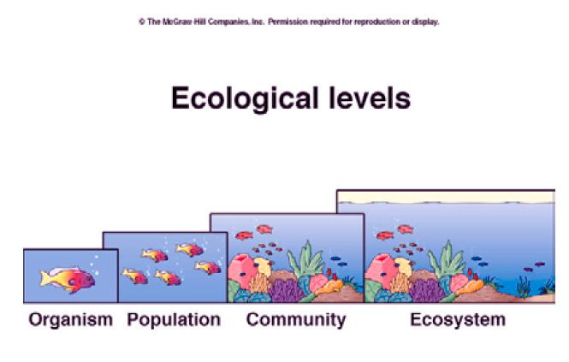
Notes:
Community - aseemblage of populations
Community is a spatial concept

Slide 19
Community attributes
Number of species
Relative abundance of species
Nature of species interactions (food webs)
Physical structure

Slide 20
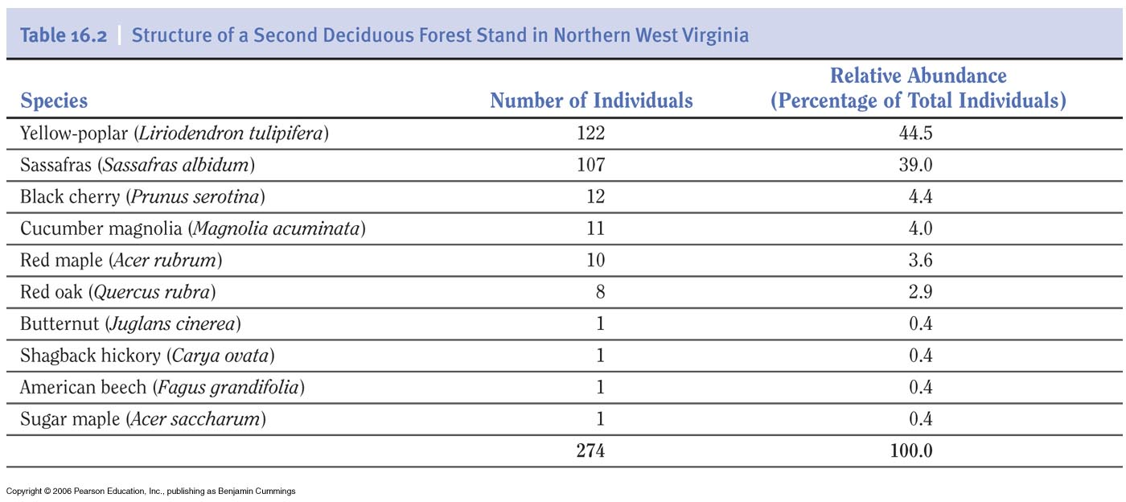
Community structure
Species richness (# of species within community)
10

Slide 21
Community structure
Relative abundance (% each species contributes to the total number of individuals)

Slide 22
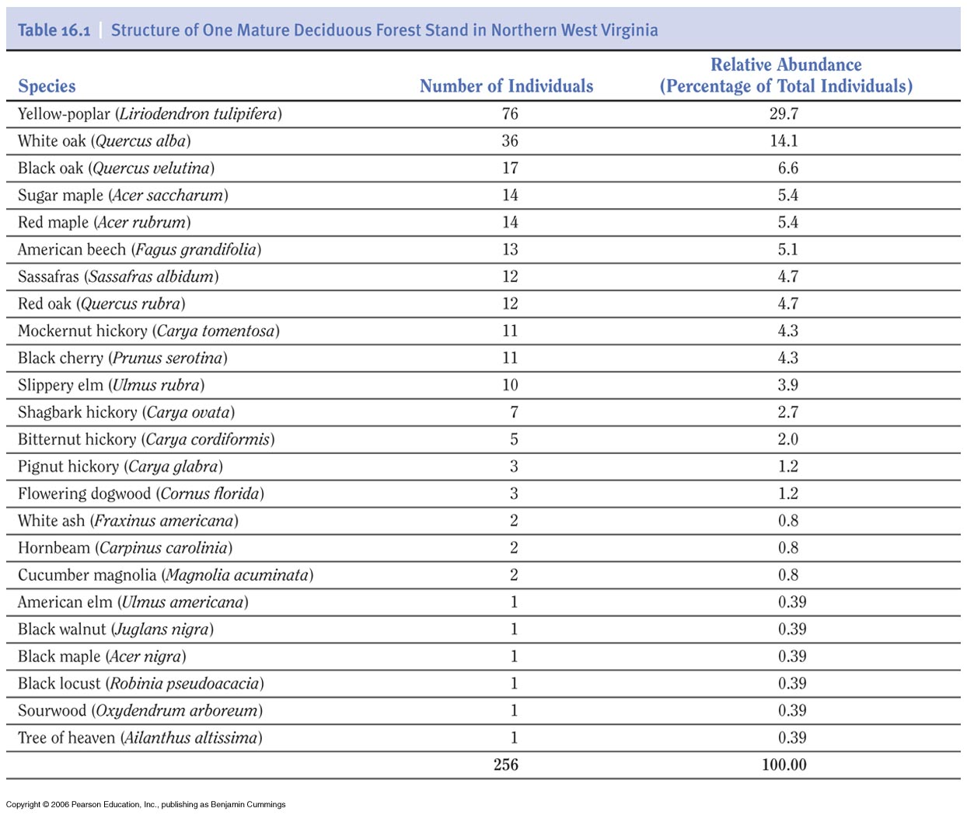
Notes:
Table 16.1

Slide 23
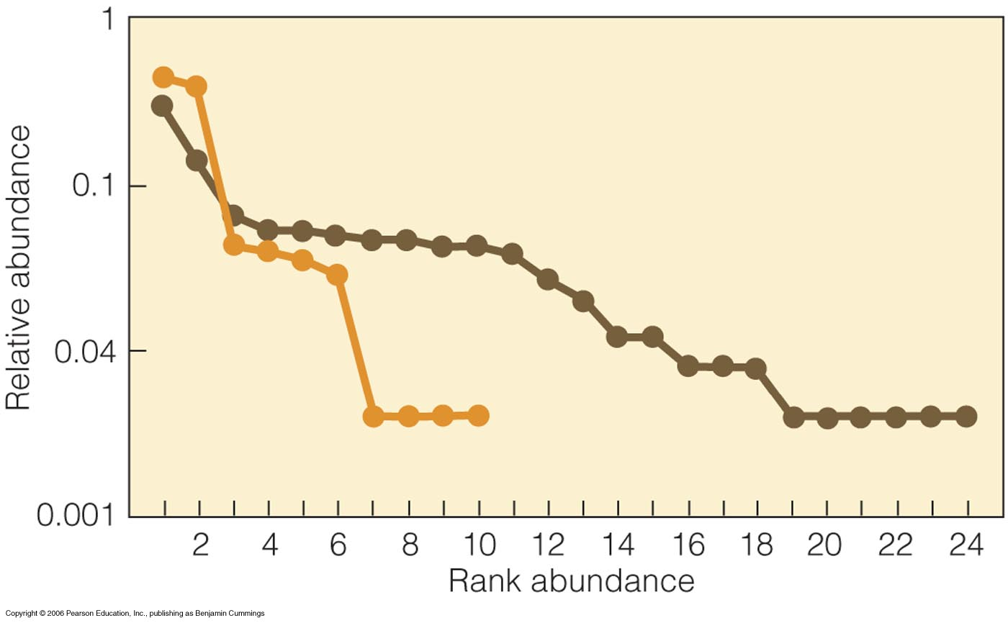
Stand one
Stand two
Notes:
Figure 16.1
Species evennes
Quantify differences

Slide 24
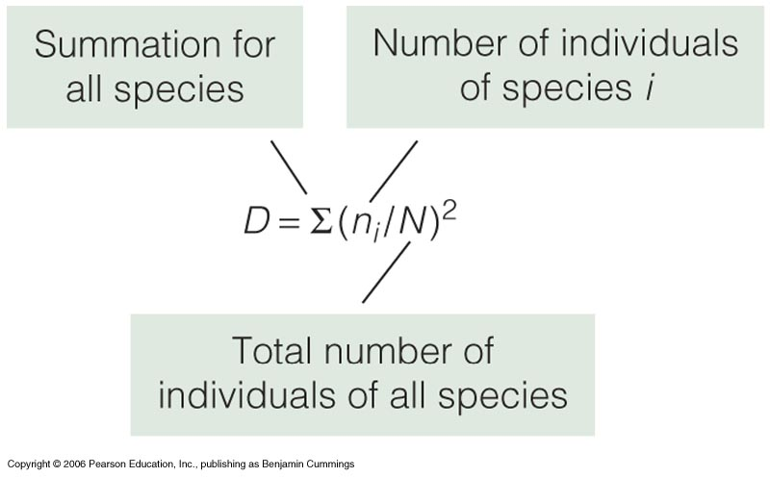
Simpson’s diversity index
D = 0 - 1
0: low diversity
1: high diversity
Stand one (Table 16.1): D=0.13
Stand two (Table 16.2): D=0.36

Slide 25
Dominance
Yellow-poplar

